Slide 1
Supervised learning
Chapter 2

Slide 2
Machine Learning (ML)
ML is a branch of AI that focuses on the development of algorithms and statistical models that can learn from and make predictions on data.
There are 3 main types of ML namely supervised, unsupervised and reinforcement.(semi-supervised).
Supervised ML is a type of machine learning where the algorithm learns from labeled data.
Labeled data means the dataset whose respective target value is already known.

Slide 3
Supervised ML
Supervised learning has two types:
Classification: It predicts the class of the dataset based on the independent input variable.
Class is the categorical or discrete values like whether the image is a cat or dog?
Regression: It predicts the continuous output variables based on the independent input variable.
Such as the prediction of house prices based on different parameters like house age, distance from the main road, location, area, etc.

Slide 4
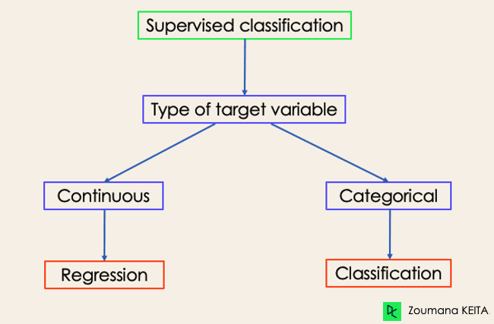
Con’t…

Slide 5
Regression
Regression is basically finding the ‘best fit line’ that passes through the maximum number of data points in the training data as possible.
This line used to predict values for our new data point.
This best fit line is also called regression equation.
There are number of regressions but for this class we will focus on linear and polynomial regression.

Slide 6
Various regressions
In case of linear regression we aim to find a straight best fit line (linear equation) and in case of polynomial regression we will find a curved best fit line (non linear equation).
If you have more than one feature based on which you want to make predictions, there is multiple linear regression rather than simple linear regression.

Slide 7
How regression work?
A regression dataset has a set of features, that are called the independent variable, these are used to make predictions.
Secondly it has a target column or the outcome which is the dependent variable that the model is trying to predict.
So, after the model is trained and is ready, given certain new data points of the independent variables the model will give a outcome of the dependent variable with certain accuracy.

Slide 8
Linear regression
Linear regression is a supervised ML algorithm that finds the best fit linear line between the independent and dependent variable i.e. it finds the linear relationship between the dependent and independent variable.
When there is only one independent feature, it is known as Simple Linear Regression, when there are more than one feature, it is known as Multiple Linear Regression.
A Linear Regression model’s main aim is to find the best fit linear line and the optimal values of intercept and coefficients such that the error is minimized.
Error is the difference between the actual value and Predicted value and the goal is to reduce this difference.

Slide 9
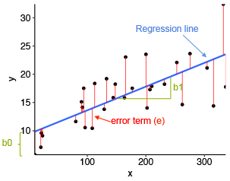
Equations
Equation of Simple Linear Regression, where b_{o} is the y intercept, b₁ is coefficient or slope, x is the independent variable and y is the dependent variable. Y = b0 + b₁x+e
Equation of Multiple Linear Regression, where bo is the intercept, b₁,b₂,b₃,b₄…,b_{n} are coefficients or slopes of the independent variables x₁,x₂,x₃,x₄…,x_{n} and y is the dependent variable. Y = b0 + b₁x+b₂x₂₊b₃x_{3+………..+} b_{n} x_{n} +e

Slide 10
Con’t…
In the above diagram,
x is our dependent variable which is plotted on the x-axis and y is the dependent variable which is plotted on the y-axis.
Black dots are the data points i.e the actual values.
b_{o} is the intercept which is 10 and b₁ is the slope of the x variable and e is error.
The blue line is the best fit line predicted by the model i.e the predicted values lie on the blue line.
The vertical distance between the data point and the regression line is known as error or residual.
Each data point has one residual and the sum of all the differences is known as the Sum of Residuals/Errors.

Slide 11

Con’t…
Mathematical Approach:
Residual/Error = Actual values – Predicted Values
Sum of Residuals/Errors = Sum(Actual- Predicted Values)
Square of Sum of Residuals/Errors = (Sum(Actual- Predicted Values))²
i.e

Slide 12
Polynomial regression
Polynomial regression is an extension of linear regression that models the relationship between the dependent variable and the independent variable(s) as an n-th degree polynomial. The equation for polynomial regression is:
y=a0+a1x+a2x2+a3x3+….+anxn
where y is dependent variable x is the independent variable and a₀,a₁,a₂,a₃,a_{n} are the coefficients.
Polynomial Regression is useful for modeling non-linear relationships where the data points form a curve.

Slide 13
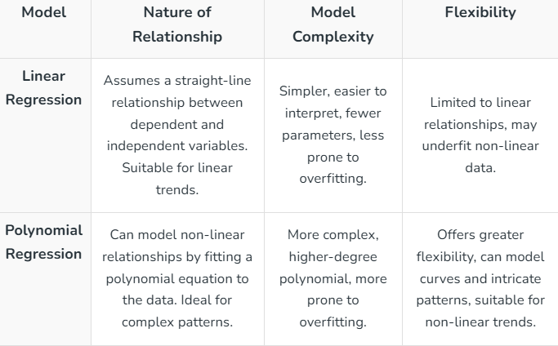
Linear Vs Polynomial Regression

Slide 14
Pros and cons of Linear regression
Advantages:
Simplicity: Easy to implement and interpret.
Efficiency: Requires fewer computational resources.
Robustness: Less prone to over-fitting with large datasets.
Disadvantages:
Limited Flexibility: Cannot model non-linear relationships.
Under-fitting: May not capture the complexity of the data if the true relationship is non-linear.

Slide 15
Pros and cons of polynomial regression
Advantages:
Flexibility: Can model a wide range of relationships.
Better Fit: Can capture non-linear trends in the data.
Disadvantages:
Complexity: More complex and harder to interpret.
Over fitting: Prone to over-fitting, especially with higher-degree polynomials.
Sensitivity to Outliers: More sensitive to outliers compared to linear regression.

Slide 16
When to Use Linear Regression vs. Polynomial Regression
Choosing between linear and polynomial regression depends on the nature of your data and the relationship between the variables you are analyzing.
Here are some scenarios to help you decide when to use each method:
Linear Regression
When the relationship between variables is linear.
When simplicity and interpretability are crucial.
With smaller datasets to avoid over-fitting.
For initial analysis to understand basic trends.

Slide 17
Real life examples of linear
Scenario: Predicting house prices based on square footage and location.(real estate pricing prediction).
Problem: Predict the selling price of houses based on features like size, location, and number of bedrooms.
Why Use Linear Regression: The relationship between house prices and their size/location is often linear.
As the size or number of bedrooms increases, the price generally increases proportionally.
Linear regression provides a straightforward model that is easy to interpret and works well with this type of data.

Slide 18
Con’t…
Scenario: Predicting next month’s sale of retail store based on advertising quality/budget and location.(Sales Forecasting for a Retail Store).
Problem: Estimate next month’s sales based on historical sales data, taking into account factors like advertising budget, seasonality, and store location.
Why Linear Regression: It provides a straightforward model to understand how different factors linearly impact sales, aiding in budget planning and marketing strategies.
Similarly, the above factors have linear relationship with sale’s of the store.

Slide 19
When to use polynomial
Polynomial Regression
When the relationship between variables is non-linear.
To capture more complex relationships in large datasets.
When flexibility is needed to fit a wider range of data shapes.
With careful consideration of the polynomial degree to avoid over-fitting.

Slide 20
Real life examples of polynomial
Scenario: Agricultural Yield Prediction Based on Environmental Conditions.
Problem: Predict the crop yield based on variables such as temperature, rainfall, and soil quality, where the relationship between these factors and yield is not linear.
Why Polynomial Regression: Environmental factors often have a non-linear impact on crop yields. Polynomial regression can model these complex relationships more effectively than linear regression.

Slide 21
Con’t…
Scenario: Modeling Electricity Consumption in Relation to Temperature
Problem: Forecast the electricity consumption of a city based on the temperature, where consumption increases during extreme cold and hot temperatures but drops at moderate temperatures.
Why Polynomial Regression: The relationship between temperature and electricity consumption is likely to be non-linear (U-shaped curve), making polynomial regression a better fit for capturing these dynamics.

Slide 22
Assumptions of Linear and polynomial Regression
Reading assignment

Slide 23
Regularization in Machine Learning
While developing machine learning models you must have encountered a situation in which the training accuracy of the model is high but the validation accuracy or the testing accuracy is low.
This is the case which is popularly known as over-fitting in the domain of machine learning.
Powerful technique known as Regularization in Python, helps to mitigate the problem of over-fitting.

Slide 24
Con’t…
Regularization introduces a penalty for more complex models, effectively reducing their complexity and encouraging the model to learn more generalized patterns.
i.e. it assign penalty term to the loss function, discouraging the model from assigning too much importance to individual features or coefficients.
This method strikes a balance between under-fitting and over-fitting, where under-fitting occurs when the model is too simple to capture the underlying trends in the data, leading to both training and validation accuracy being low.

Slide 25
Over-fitting
Over-fitting is a phenomenon that occurs when a Machine Learning model is constrained to the training set and not able to perform well on unseen data.
That is when our model learns the noise in the training data as well.
This is the case when our model memorizes the training data instead of learning the patterns in it.

Slide 26
Under-fitting
Under-fitting on the other hand is the case when our model is not able to learn even the basic patterns available in the dataset.
In the case of the under-fitting model is unable to perform well even on the training data hence we cannot expect it to perform well on the validation data.
This is the case when we are supposed to increase the complexity of the model or add more features to the feature set.

Slide 27
Bias and Variance
Bias refers to the errors which occur when we try to fit a statistical model on real-world data which does not fit perfectly well on some mathematical model.
If we use a way too simplistic a model to fit the data then we are more probably face the situation of High Bias which refers to the case when the model is unable to learn the patterns in the data at hand and hence performs poorly.
Variance implies the error value that occurs when we try to make predictions by using data that is not previously seen by the model.
There is a situation known as high variance that occurs when the model learns noise that is present in the data.

Slide 28
Bias Variance tradeoff
The bias-variance tradeoff is a fundamental concept in machine learning. It refers to the balance between bias and variance, which affect predictive model performance.
Finding the right tradeoff is crucial for creating models that generalize well to new data.
The bias-variance tradeoff demonstrates the inverse relationship between bias and variance.
When one decreases, the other tends to increase, and vice versa.
Finding the right balance is also important.
An overly simple model with high bias won’t capture the underlying patterns, while an overly complex model with high variance will fit the noise in the data.

Slide 29
Benefits of Regularization
Regularization improves model generalization by reducing over-fitting. Regularized models learn underlying patterns, while over-fit models memorize noise in training data.
Regularization techniques such as L1 (Lasso) L1 regularization simplifies models and improves interpretability by reducing coefficients of less important features to zero.
Regularization improves model performance by preventing excessive weighting of outliers or irrelevant features.
Regularization makes models stable across different subsets of the data.
It reduces the sensitivity of model outputs to minor changes in the training set.

Slide 30
Con’t…
Regularization prevents models from becoming overly complex, which is especially important when dealing with limited data or noisy environments.
Regularization can help handle multi-collinearity (high correlation between features) by reducing the magnitudes of correlated coefficients.
Regularization introduces hyper-parameters (e.g., alpha or lambda) that control the strength of regularization. This allows fine-tuning models to achieve the right balance between bias and variance.
Regularization promotes consistent model performance across different datasets. It reduces the risk of dramatic performance changes when encountering new data.

Slide 31
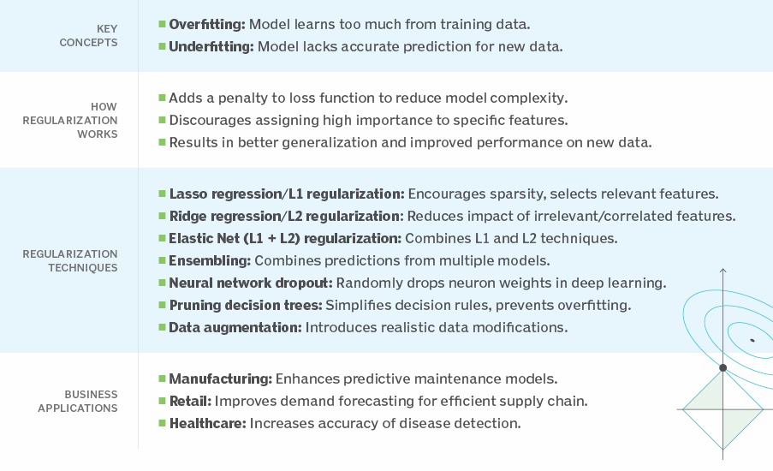

Slide 32
Evaluation metrics
There are three error metrics that are commonly used for evaluating and reporting the performance of a regression model; they are:
Mean Squared Error (MSE).
Root Mean Squared Error (RMSE).
Mean Absolute Error (MAE)

Slide 33
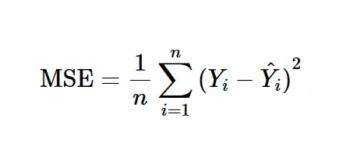
MSE
Mean Squared Error is a popular error metric for regression problems.
The MSE is calculated as the mean or average of the squared differences between predicted and expected target values in a dataset.
Where Yi is the i’th expected value in the dataset and second Yi is the i’th predicted value.
Squaring the errors will guarantee that we do not have any negative values — so the lowest score we can get is 0 — and it also gives more weight to larger differences.

Slide 34
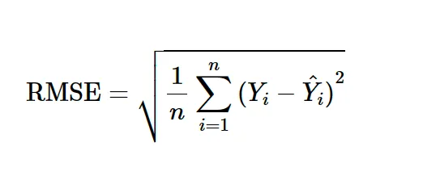
RMSE
The Root Mean Squared Error, or RMSE, is an extension of the mean squared error.
Importantly, the square root of the error is calculated, which means that the units of the RMSE are the same as the original units of the target value that is being predicted.
It is common to use MSE to train a regression predictive model, and to use RMSE to evaluate and report its performance. RMSE = sqrt(MSE)
The closer to 0, the better the model’s performance.

Slide 35
MAE
Mean Absolute Error, or MAE, is a popular metric because, like RMSE, the units of the error score match the units of the target value that is being predicted.
Unlike the RMSE, the changes in MAE are linear and therefore intuitive.
MSE and RMSE punish larger errors more than smaller errors, inflating or magnifying the mean error score due to the square of the error value.
The MAE does not give more or less weight to different types of errors and instead the scores increase linearly with increases in error.

Slide 36
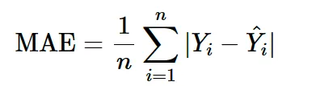
Con’t…
As its name suggests, the MAE score is calculated as the average of the absolute error values.
Absolute or abs() is a mathematical function that simply makes a number positive.
Therefore, the difference between an expected and predicted value may be positive or negative and is forced to be positive when calculating the MAE.
The MAE can be calculated as follows:

Slide 37
Thanks

